Slide 1

Student Result Processing System
Neha Chaudhary - 20104134
Kritika Donde - 20104102
Ashmina Dangat - 20104052
Sakshi Gunjal - 20104106
Project Guide
Prof. Apeksha Mohite

Slide 2
Contents
Introduction
Objectives
Scope
Features / Functionality
Project Outcomes
Technology Stack
Block Diagram

Slide 3
Introduction
Problem Identified :
Manual processing of Student result in Institutes is time consuming and complicated.
There is a possibility of mistakes and errors.
In Student’s case, it is not always possible to visit Institutes to collect result.
2. Solution Proposed :
A system where it is easy for Admin to develop Student’s result with very less efforts and store it.
And for Students it is easy to access results from the system rather then visiting the Institutes.

Slide 4
2. Objectives
To build an efficient result portal
To build a system that is useful to both students as well as the authority
To come up with an arrangement that makes overall handling of data easier and flexible
To develop an user-friendly portal that can be accessible anywhere anytime.

Slide 5
3. Scope
Can be useful to colleges, schools and other authorities to manage and display results.
Can be used by students to view their performance/results.
Can be used to store student results in a secured database.

Slide 6
4. Feature /Functionality
Easy to manage student results :
    Adding marks, viewing or making any changes to records/ student data.
Easy to access results :
    Users can view results anytime. They can also download their results as a pdf file.
System is reliable, accurate and secure :
    Since it is not a manual system, there will be no errors hence giving fully accurate results.
    Server is secure so no risk of mismanagement of data.

Slide 7
5. Outcome of Project
For admin login
Admin can login by providing following inputs:
Username
Password
Admin can add new student/record/results
Admin can view all added records
Admin can also amend/make changes to existing records

Slide 8
For student login
Student can login by providing following inputs:
Username
Password
Student can view their result.
Student can also download results.

Slide 9
6. Technology Stack
Frontend- Java
Backend- MYSQL

Slide 10
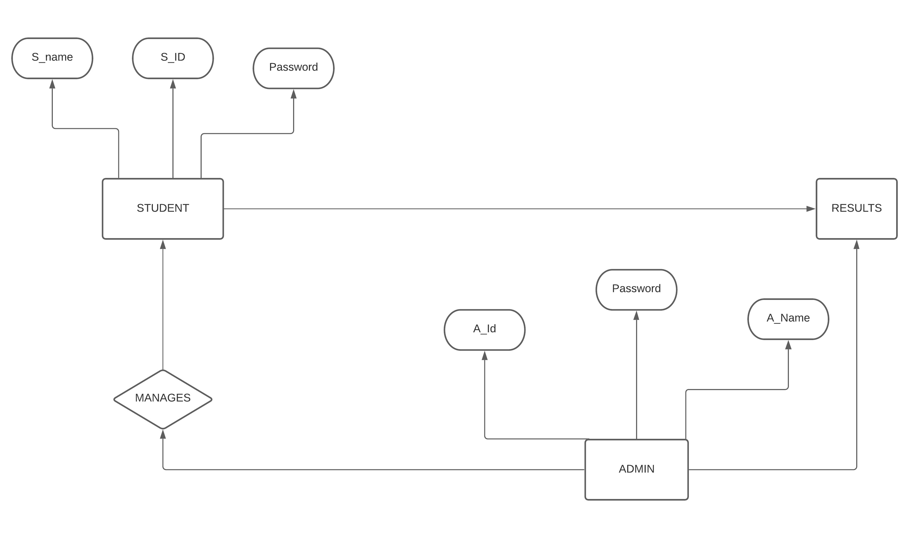
7. Block Diagram

Slide 11
Thank You...!!

